Slide 1
Communication and data curation

Slide 2
V1. Communication issues in data curation
As we have seen: communication is central to almost every area of data curation . . . And is itself an area of data curation
Scientific communication of data and the results of data analysis
is an essential part of science, technology, and scholarship,
with effects in two directions
Of course more data, and more data analysis, is a good thing,
but the increase is causing a crisis in scientific communication

Slide 3
Communication and the data curation
As we have seen communication is central to almost every area of data curation
[And it itself an independent area]

Slide 4
Areas of curatorial activities
Collection: Organization: Storage: Preservation: Discoverability: Access: Workflow: Identification: Integration: Reformatting: Reproducibility: Sharing: Communication: Provenance: Modification: Compliance: Security:
Support the collection and acquisition of data
Employ an appropriate data model and use appropriate standards Support reliable and effective storage
Ensure that data will be understandable and useable in the future Support the ability to search for and locate relevant data
Support the ability to retrieve and distribute data Support the ability to systematize data workflows
Support the ability to identify, authenticate, and validate data
Support integration of data from different sources using different data models Support reformatting for use by different tools or to match new format standards Support ability to reproduce results, ensuring scientific validity
Support sharing data between researchers, teams, and institutions.
Support representation, publishing, and visualizations that provide insight Support identifying what inputs and calculations are responsible for data values Support management of corrections and updates
Ensure compliance to legal, regulatory, and local policy requirements
Ensure that data is secure from tampering or inappropriate access and distribution

Slide 5
Our definition of data science
(again)
Data science is concerned with all aspects of
the creation, management, analysis, and communication of data
focusing in particularly on
the application of computational methods to digital data
The data science objective:
extracting useful knowledge from data

Slide 6
Methods of curatorial action
There are many methods and techniques employed to achieve the objectives just listed, but five categories stand out as particularly important:
Analysis
To determine needs, and develop relevant data models and metadata, and reformat, correct, or update data.
Documentation
To record essential information (typically via metadata)
System design and implementation
To support all data curatorial activities
To support the generation and use of data documentation and processing documentation
Policy
To specify objectives, procedures, practices, and formats.
Process
To ensure success and efficiency by managing the development of appropriate organizational units and roles, providing training, advocating for change, and managing curatorial activities.

Slide 7
What we will take up next
Ok, communication is relevant to many aspects of data curation But we have a particular focus this week:
Scientific and technical communication
particularly journal literature, where scientific results are reported

Slide 8
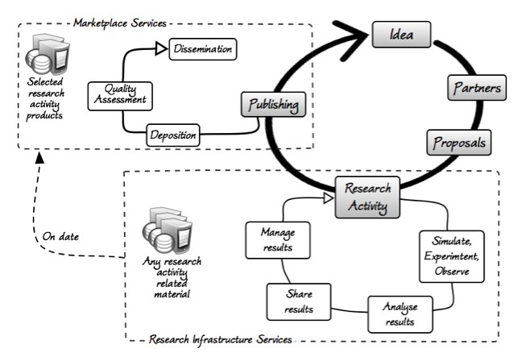


Scientific communication is how data gets noticed
[After all, if the results of analyzing data are not communicated, then what’s the point of it all?]
Scientific and technical communication is a critical part of the data lifecycle, with effects flowing both ways:
from the research process,
and back into the research process.
image from “Science 2.0 Repositories: Time for a Change in Scholarly Communication” Massimiliano Assante et al., D-Lib Magazine 2015.

Slide 9
. . . the crisis
But scientific and technical publishing is in crisis
as we’ll see in the next video

Slide 10
V2. The crisis in data-driven scientific communication
A story about Lisa
The scientific literature explosion Solutions that won’t (completely) work

Slide 11
Scientific communication is how data gets noticed
[After all, if the results of analyzing data are not communicated, then what’s the point of it all?]
Scientific and technical communication is a critical part of the data lifecycle, with effects flowing both ways:
from the research process,
and back into the research process.

Slide 12
. . . the crisis
But scientific and technical publishing is in crisis
a problem caused by data
and that can be addressed with data
as we’ll see in the next video

Slide 13
Introducing Lisa
(DOB: January 1, 2000)
Today she is 17, just starting college
All her life she has been using the Web, Google, FB, smart phones…
Now let’s look ahead just 8 years, to 2026
Lisa has just finished her doctoral coursework in molecular biology, and she is about to start her research.
She walks up to the science reference desk…

Slide 14
Lisa at the science reference desk in 2026
Why is she there?
Does she need to know some fact?
Does she need to find a resource?
Does she need to know how to use a resource?
She begins:
“I’m studying the role of the P53 in Huntington’s disease… ”*
The reference librarian interrupts…
“So you’d like to find some articles to read on P53?”
[ they both laugh ]
Why do they laugh?
[*]Inspired by John Wilbanks, various presentations 2005-2007; and comments by MacKenzie Smith, Associate Director, MIT Libraries

Slide 15
Because the reference librarian is making a joke.
In 2026
no one is “looking for articles to read”
(at least not in science)
in 2026 engaging with the scientific literature
will (finally) be like
“flying a jet plane through information space”*
and not at all like finding and reading articles
*attributed to Alan Kay, mid-1980s,

Slide 16
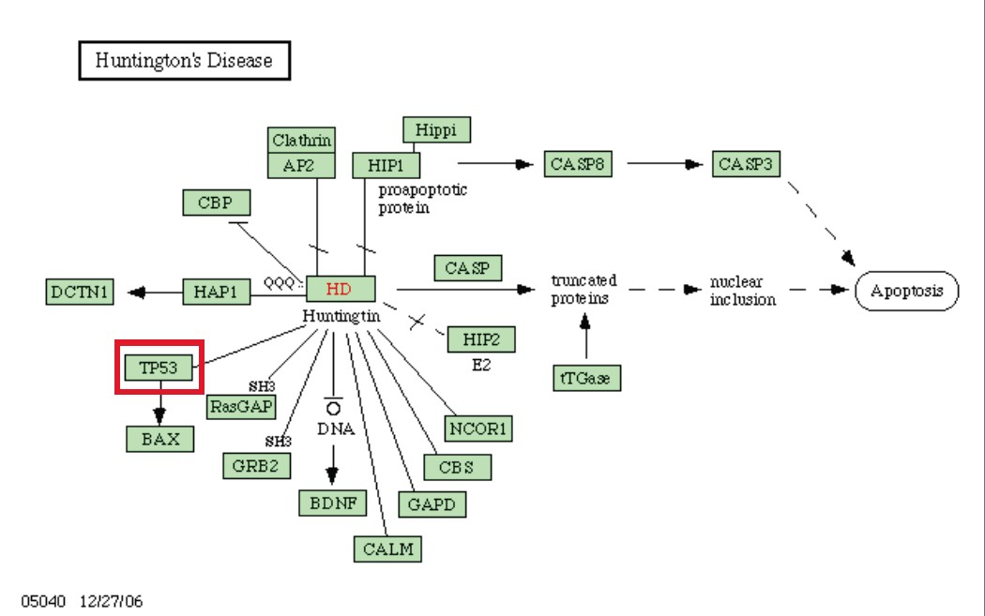
Lisa’s problem: P53
from John Wilbanks, adapting a KEGG map
8

Slide 17
Lisa’s problem
79,149 *
*PubMed citations with P53 in
the [title/abstract] in November 2017
… and in 2026??
from John Wilbanks, adapting a KEGG diagram
9

Slide 18
A tipping point has been reached
“Nowadays … sets of relevant papers [are] identified that surpass human capability for reading, interpretation, and synthesis.”
– Barend Mons
“Which gene did you mean?”
This is the problem that contemporary data generation and tools has created.
10

Slide 19
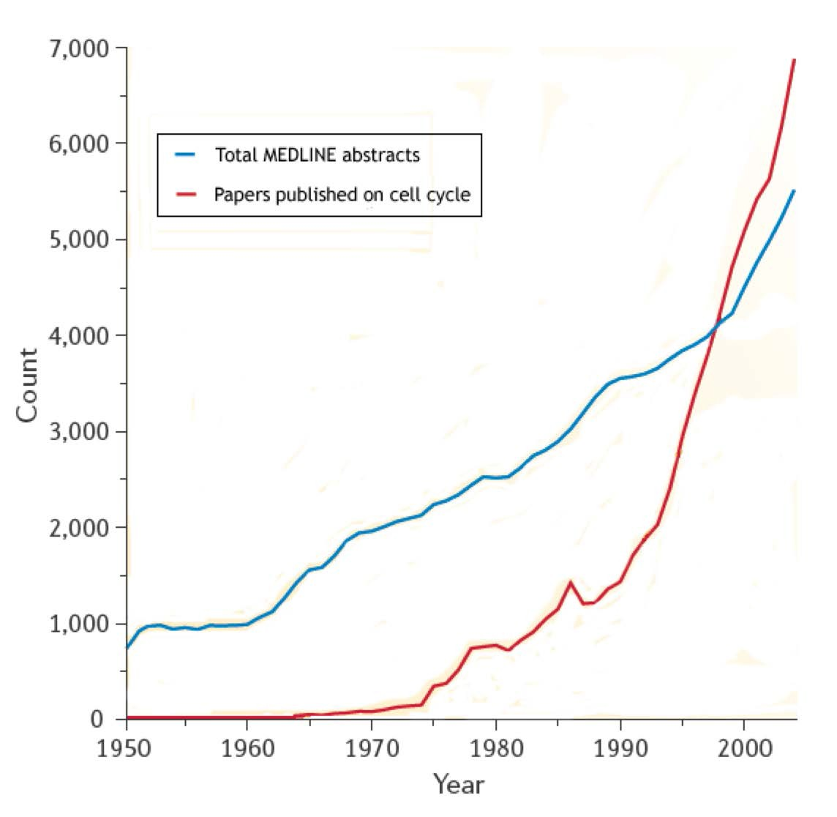
Are you kidding me???
[Axis is x10⁻² for total Medline abstracts]
Adapted from Jensen, Saric, & Bork; Nature (2006).
11

Slide 20
Responses to the problem
One response:
text mining instead of reading
» information extraction
» “undiscovered public knowledge” and hypothesis generation
(Swanson and Smalheiser
Another response:
tools for strategic reading
12

Slide 21
V3. The solution to the data crisis is . . . more data
Recall the problem: more relevant articles than any specialist could possibly read Background: How do scientists and other professionals read these days?
How could we help them read better?
Examples, obstacles, the future

Slide 22
Are you kidding me???
[Axis is x10⁻² for total Medline abstracts]
Adapted from Jensen, Saric, & Bork; Nature (2006).
3

Slide 23
Some big numbers
25,000 publishers
1.5 million scholarly articles a year
600,000 abstracts added to Medline each year
4

Slide 24
So, how do scientists and other professionals engage the literature

Slide 25
User behavior during (scientific) search
in, e.g., PubMed, SCOPUS, Google Scholar, Web of Science, ADS, etc.
The search trance.
Researchers engage with the literature as if playing a video game
They rapidly, almost subconsciously…
develop queries likely to find known items, or retrieve subject or topic results
track references backward and citations forward,
make rapid relevance judgments: assessments of impact, and quality
locate and compare key terms, equations, definitions, protocols, findings
This is almost sub-cognitive, kinaesthetic, even trance-like,
sessions are often considered successful
— even though no article to read was found and read!!
6

Slide 26
Their goal appears to be not finding an article to read. . .
but avoiding reading
Now, this is nothing new…
indexing and citation analysis help decide whether articles are relevant…
without reading them.
abstracts and literature reviews help us take advantage of articles …
without reading them.
the articles we do read, in their analyses and summaries help us take advantage of other articles
… without reading them.
friends, colleagues, and, best of all, graduate students, help us take advantage of articles …
without reading them.

Slide 27
Paper based strategic reading
… engineers describe a common pattern for utilizing document components by zooming … and filtering information …
[they] first read the abstract, then skim section headings.
Next … lists, summary statements, definitions, and illustrations.
… they disaggregate and re-aggregate article components for use in their own work … perhaps by using a marker to highlight … perhaps by creating a mental register…
— Bruce Schatz et al.
“Federated Search of Scientific Literature”
IEEE Computer, 1999.

Slide 28
Online strategic reading
[informant] …
I used the sections of the papers for the equations….
I even wouldn’t read all the other parts of the article …
l look for specific surface tensions, experimental measurements …
I sometimes need to look specifically at other methods and theories.
— Ann Bishop
“Document Structure and Digital Libraries: How Researchers Mobilize Information in Journal Articles” Information Processing and Management, 1999.

Slide 29
Longstanding behaviors, sure: but newly urgent
Key studies from C. Tenopir and D. King (2000-2007) show …
time searching and browsing has been rising rapidly from 1984 to 2000.
until the mid-1990s the number of articles “read” was more or less steady.
but since then the number “read” (not “browsed”) has been climbing
and so reading time per article is dropping, in some fields fairly fast (< 24 minutes!)
In addition studies from C. Palmer et al (2000-2007) show …
researchers use sophisticated techniques to mobilize information according to varied research needs.
these information needs vary with discipline, research life cycle (local and global), and research strategies, as well as with varying affordances of current technology
the pace of evolution and innovation in these techniques is increasing, and increasingly driven by researchers themselves and not information specialists or publishers
10

Slide 30
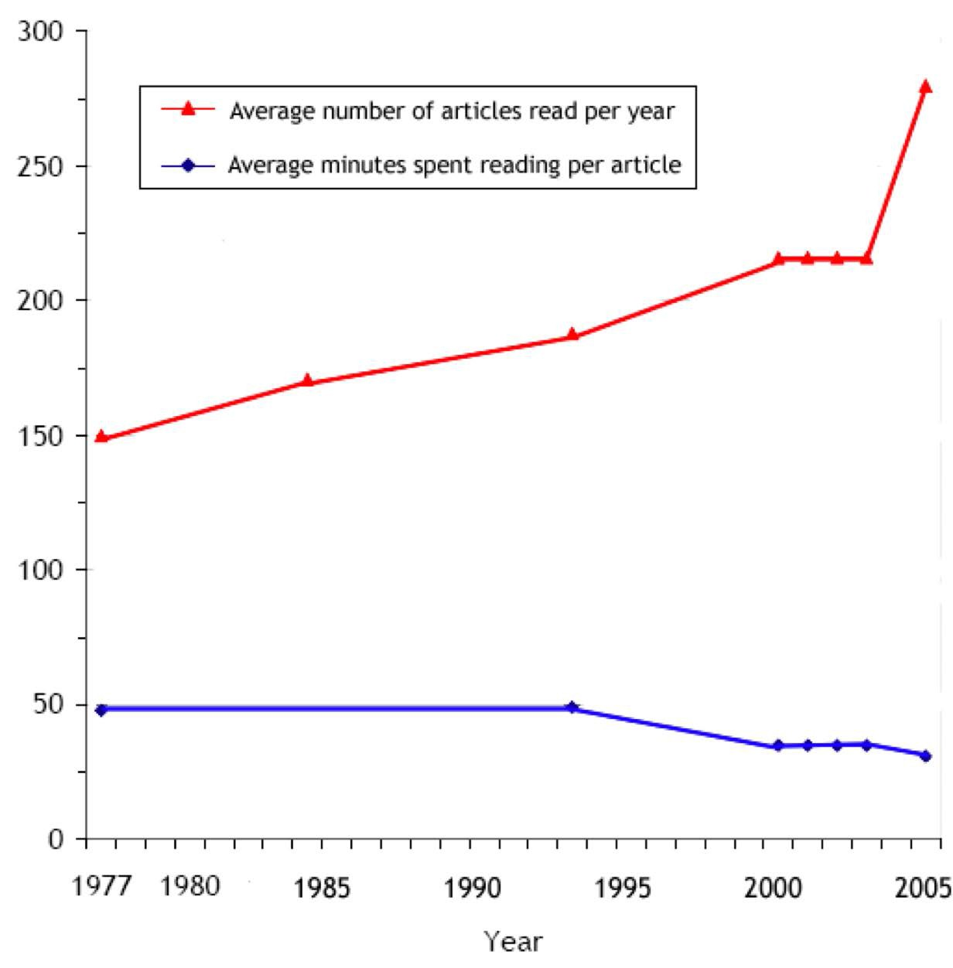
Faster, faster, faster, more more more
Tenopir et al. 1977-2005
11

Slide 31
So what to do??
Human reading of natural language prose is uniquely valuable, providing nuance, clarity, and insight. So reading cannot be totally replaced by text mining
So let’s provide tools that support strategic reading
For example
computationally available data items accessible with discipline-specific tools (chemical formulae, proteins, equations, etc.)
advanced navigation and viewing
optimized for domain-specific and objective-specific browsing and analysis,
typed hypertext linking with links as first class objects,
data-driven interactive diagrams and graphics
computable equations,
supportive ontological inferencing
thoroughgoing interoperability with other tools
… and so on, and on, and on.
the grand old dream of radical new functionality as envisioned by
Paul Otlet, Vannevar Bush, Douglas Engelbart, Ted Nelson et al.

Slide 32
More of what scientists want. . .
The datument is a hypermedia document accessible to robots and humans
… for transmitting “complete” information including content and behaviour.
… the machine is … semantically aware of the document content [through] domain-specific XML components...
We argue that a cultural change in our approach to information is needed.
P. Murray-Rust and H.S. Rzepa[*] “The Next Big Thing: From Hypermedia to Datuments,”
Journal of Digital Information, 5:1 2004
[*]Chemistry faculty at Cambridge University and Imperial College London, respectively.
Imagine what could be achieved if articles, rather than consisting entirely of free-form natural languages, contained explicit assertions about biological knowledge in unambiguous machine readable form … some progress is being made…
Mathew Cockerill, Editorial,
BMC Bioinfomatics, 6:140 2005

Slide 33
In a nutshell
As scientific ontologies are integrated into the publishing workflow many enhancements to scientific communication will become possible
…support for text mining, information extraction, and literature-based discovery.
And one is not so obvious,
… support for the long-standing practice of strategic reading
“Strategic Reading and the Future of Scientific Publishing” Allen H. Renear, Carole L. Palmer,
Science, August 16 2009.

Slide 34
Necessary data standards are now, finally, in place
Character encoding interoperability
Unicode/UTF-xx [Adoption: nearly total]
Data structure serialization interoperability XML, JSON
[Adoption: nearly total]
Syntactic interoperability
i.e. RDF(S), OWL
[Adoption: underway]
Semantic interoperability
RDF/OWL ontologies; linked data.
[Adoption: substantial]
Document markup meta-languages
XML
[Adoption: nearly total]
Document markup languages
e.g,
NLM/DTD, XHTML, TEI, DocBook, DITA
[Adoption: widely adopted]
Metaphysical interoperability
“upper” ontologies
[Adoption: (hard to say)]
Domain ontologies and terminologies
hundreds
[Adoption: steady improvements]

Slide 35
Some examples . . .

Slide 36
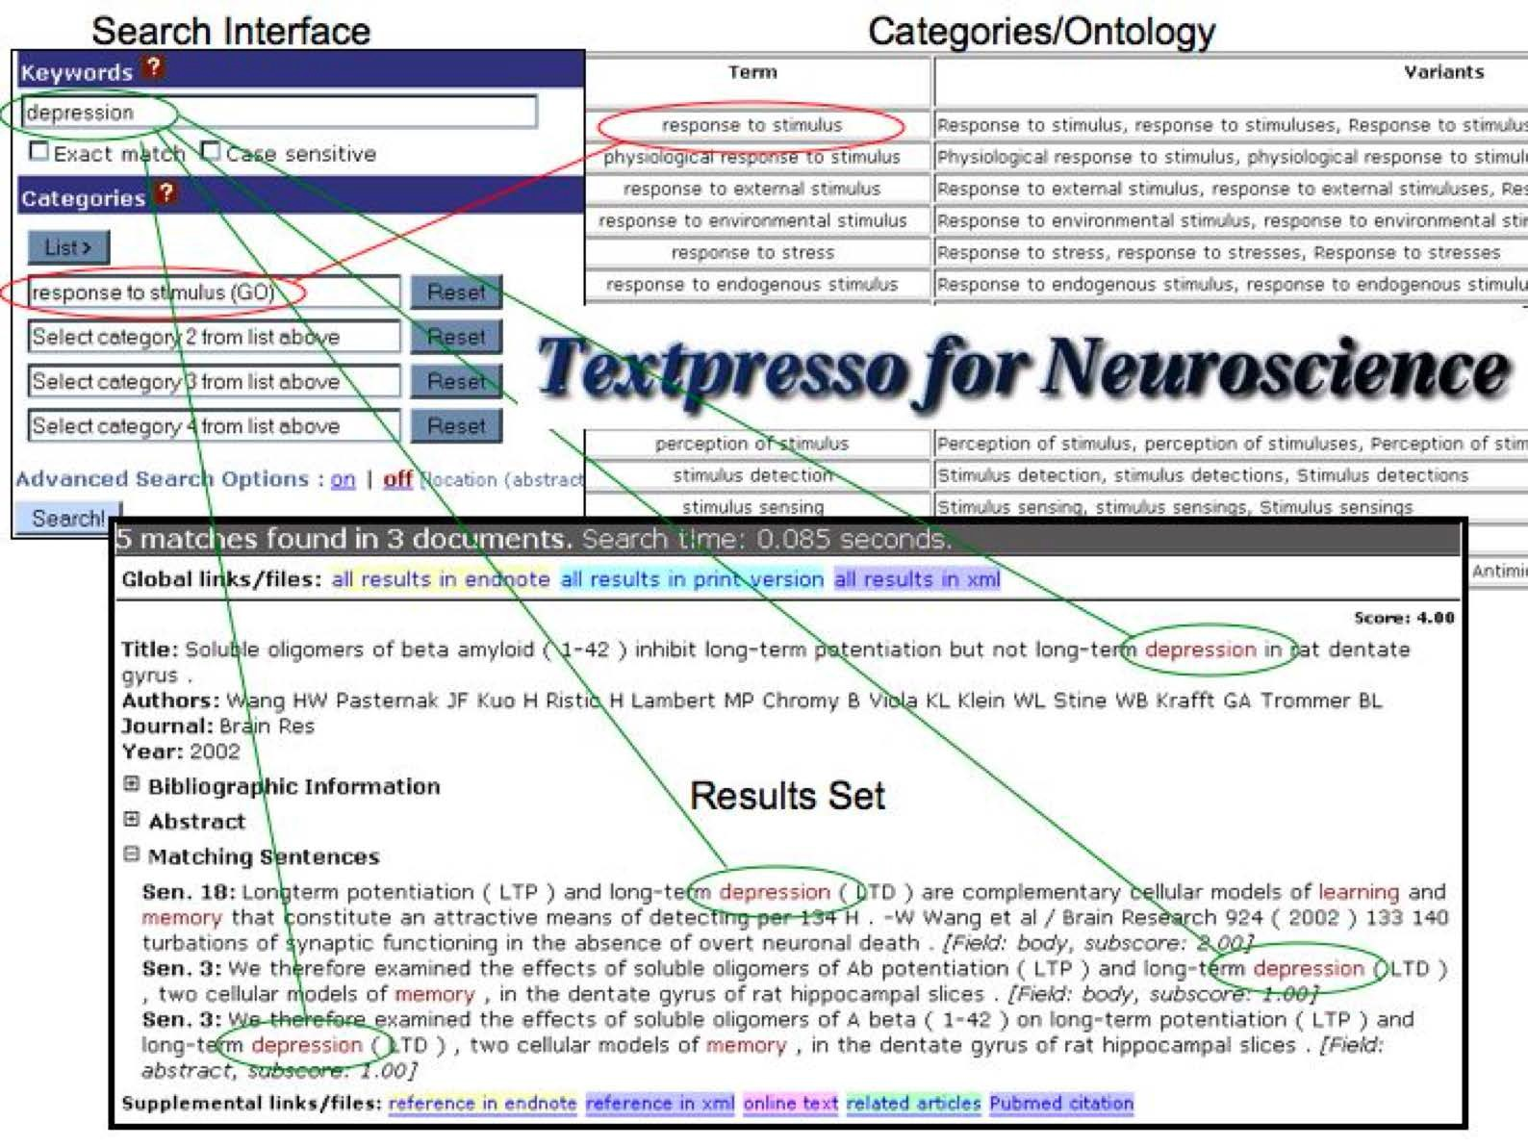
Hoffmann, R; Valencia, A (Jul 2004).
"A gene network for navigating the literature.".
Nature Genetics. 36 (7): 664.

Slide 37
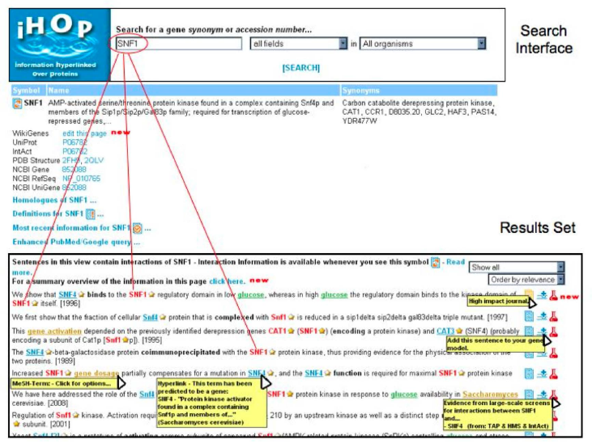
Muller HM, Kenny EE, Sternberg PW “Textpresso: an ontology-based information retrieval and extraction system for biological literature” PLoS Biol. 2004 Nov;2(11)..

